Slide 1

AGE 310: Instrumentation and Measurements
Lecture 7: Actuators & Output Devices
Instructor: Dr. Kadeghe Fue
Department of Agricultural Engineering
Sokoine University of Agriculture (SUA)

Slide 2


Recap & Objectives
Recap: Lecture 6
Lecture 7 Objectives
We covered Signal Conditioning (Op-Amps, Filters, ADCs). We now have a clean, digital signal ready for decision making.
Define Actuators and their role in the control loop.
Classify actuators: Electrical, Hydraulic, Pneumatic.
Analyze Solenoids, DC Motors, Steppers, and Servos.
Understanding Fluid Power (Hydraulic Cylinders).
Application: Variable Rate Technology (VRT).

Slide 3

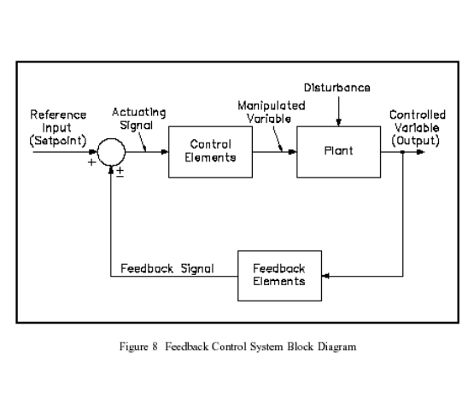
Closing the Control Loop
The "Action" End
So far, we have only "observed" the system (Sensors → Conditioning → Controller).
Now we must "act" upon it.
The Actuator accepts the command signal from the controller and converts it into physical energy to change the process variable.

Slide 4







What is an Actuator?
An actuator is a transducer that converts a control signal (usually low power electrical) into mechanical motion.
Electrical
Hydraulic
Pneumatic
Clean, easy to control, high precision.
High force/torque, messy, requires pump.
Fast, clean, compliant (compressible).
Motors, Solenoids, Piezo.
Cylinders, Hydraulic Motors.
Air Cylinders, Air Muscles.

Slide 5

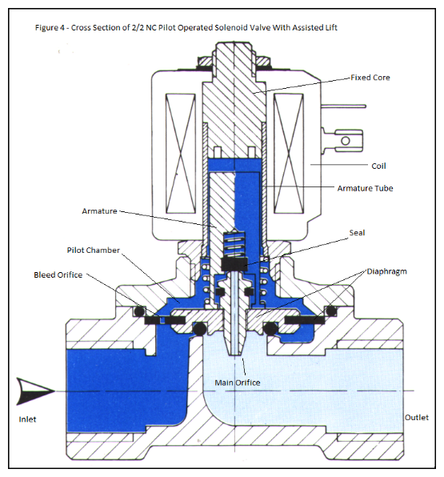
1. Solenoids
Linear Actuation (On/Off)
A coil of wire wound around a movable ferrous core (plunger). When energized, the magnetic field pulls the plunger in.
Ag Application: Solenoid valves in drip irrigation systems and fuel shut-off valves in tractors.

Slide 6

2. Relays & Contactors
The Concept
Why use them?
An actuator that operates a switch.
Isolation: Keeps the high voltage (220V AC or 12V High Amps) away from the delicate microcontroller (5V).
A small current (from Arduino/ECU) energizes a coil, creating a magnetic field that closes high-current contacts.
Ag Application: Turning on pump motors, headlights, or fan motors.

Slide 7


3. DC Motors
Converts electrical energy into continuous rotation.
Brushed DC
Brushless DC (BLDC)
Simple, cheap.
High efficiency, high torque, no sparks.
Cons: Brushes wear out, creates sparks (EMI).
Cons: Requires complex controller (ESC).
Used in Drones and EV tractors.

Slide 8
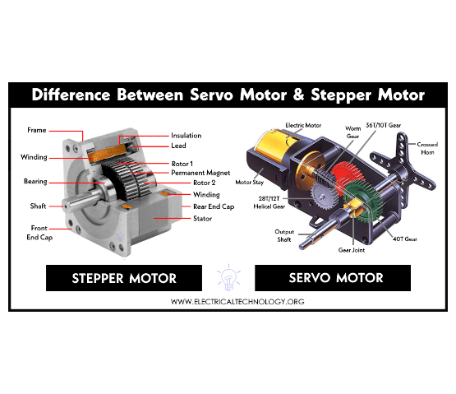
4. Stepper Motors
Precise Positioning
Moves in discrete "steps" (e.g., 1.8° per step).
Open Loop Control: We tell it to move 50 steps, and we assume it did. No feedback sensor needed.
Ag Application: Metering rollers in seed drills (Variable Rate Seeding).

Slide 9
5. Servo Motors
Closed Loop Control
Ag Application
Consists of a DC Motor + Gearbox + Potentiometer (Position Sensor) + Control Circuit.
Auto-Steering Systems: An electric motor on the steering wheel that maintains the exact angle required by GPS.
It actively corrects its position. If you try to push it, it pushes back.
Throttle Control: Precise engine speed regulation.

Slide 10
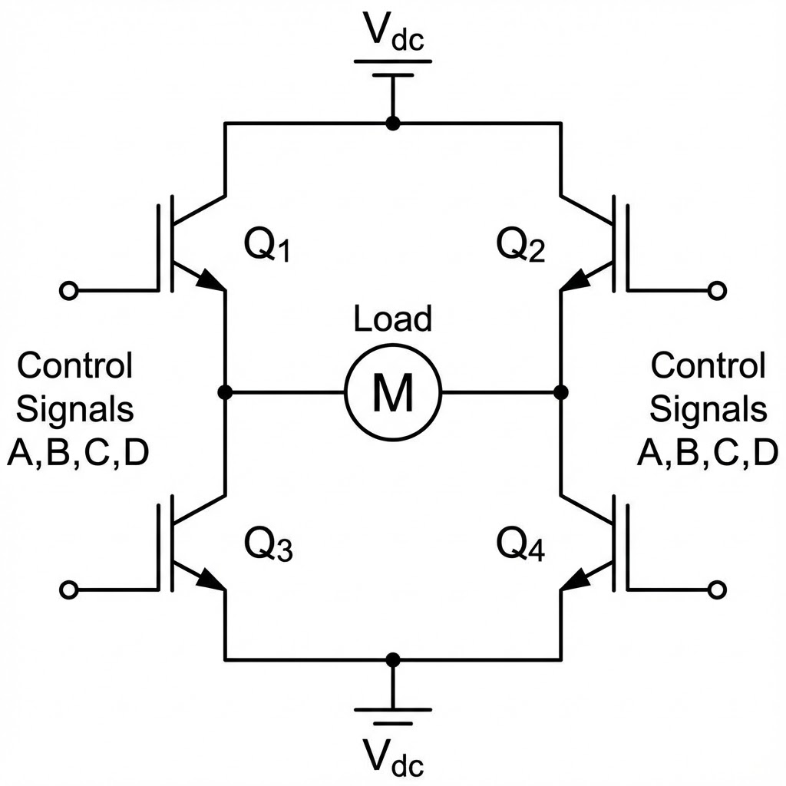
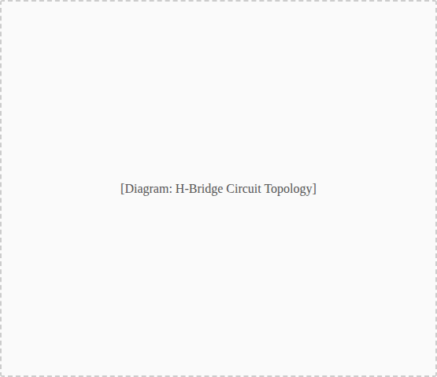
Motor Control: The H-Bridge
Bi-Directional Control
A microcontroller cannot reverse the polarity of a battery to reverse a motor.
An H-Bridge is a circuit of 4 switches (Transistors/MOSFETs) that allows current to flow in either direction through the motor.
Essential for any robotics or automated machinery.

Slide 11

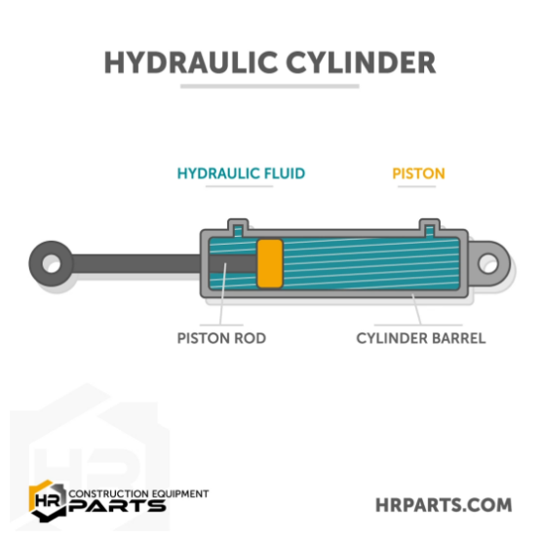

Fluid Power: Hydraulics
Why Hydraulics?
Power Density: A small hydraulic motor provides 10x the torque of an electric motor of the same size.
Pascal's Law: Pressure applied to a confined fluid is transmitted undiminished.
Force = Pressure (Oil) × Area (Piston)

Slide 12

The Hydraulic Cylinder
Single Acting
Double Acting
Power to extend, gravity (or spring) to retract.
Power to extend AND power to retract. Two oil ports.
Ex: Tipping trailer.
Ex: Steering cylinder, Front-end loader bucket.
Note: Retraction force is always less than extension force (due to the rod area reducing the effective piston area).

Slide 13







Fluid Power: Pneumatics
The Medium
Characteristics
Ag Application
Compressed Air. Clean, available everywhere.
Compressible (spongy). Fast actuation. Lower force than hydraulics.
Milking machines (pulsators), Seed singulation (vacuum planters).

Slide 14
Comparison: Actuator Types
Feature | Electric | Hydraulic | Pneumatic
Power Density | Medium | Very High | Low
Precision | Excellent | Good | Poor
Speed | High | Medium | Very High
Maintenance | Low | High (Leaks) | Medium

Slide 15

Final Control Elements: Valves
The actuator often drives a valve to control flow.
Solenoid Valve: On/Off control (Irrigation zones).
Proportional Valve: Variable flow control based on voltage (Variable rate spraying).
Check Valve: One-way flow.

Slide 16
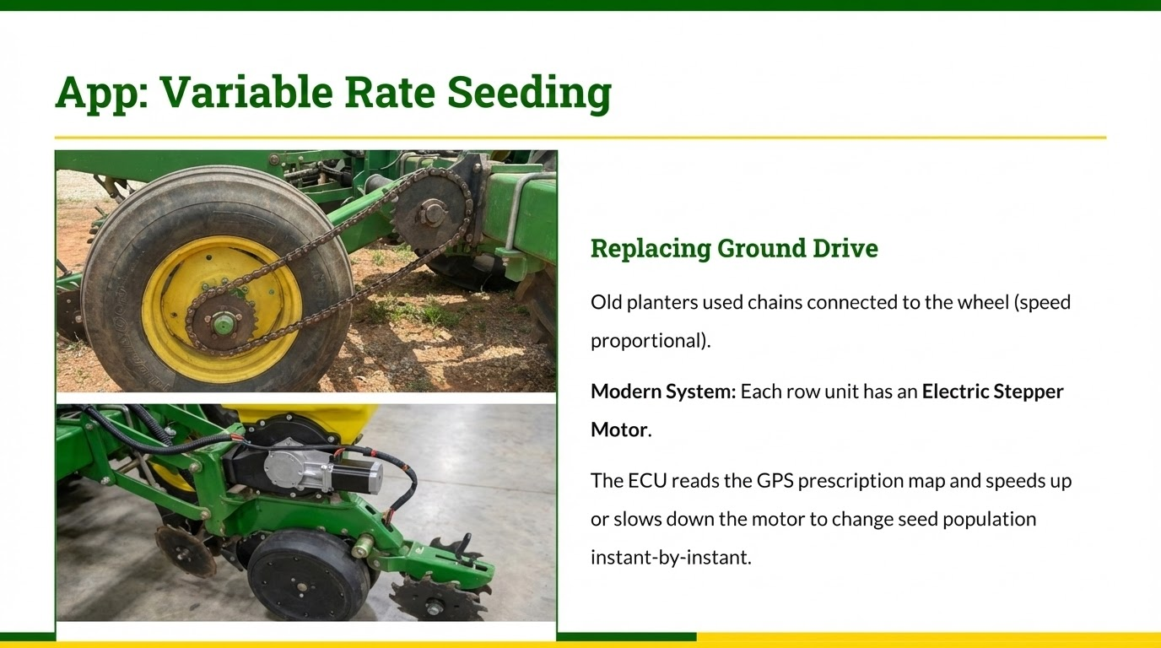

Slide 17
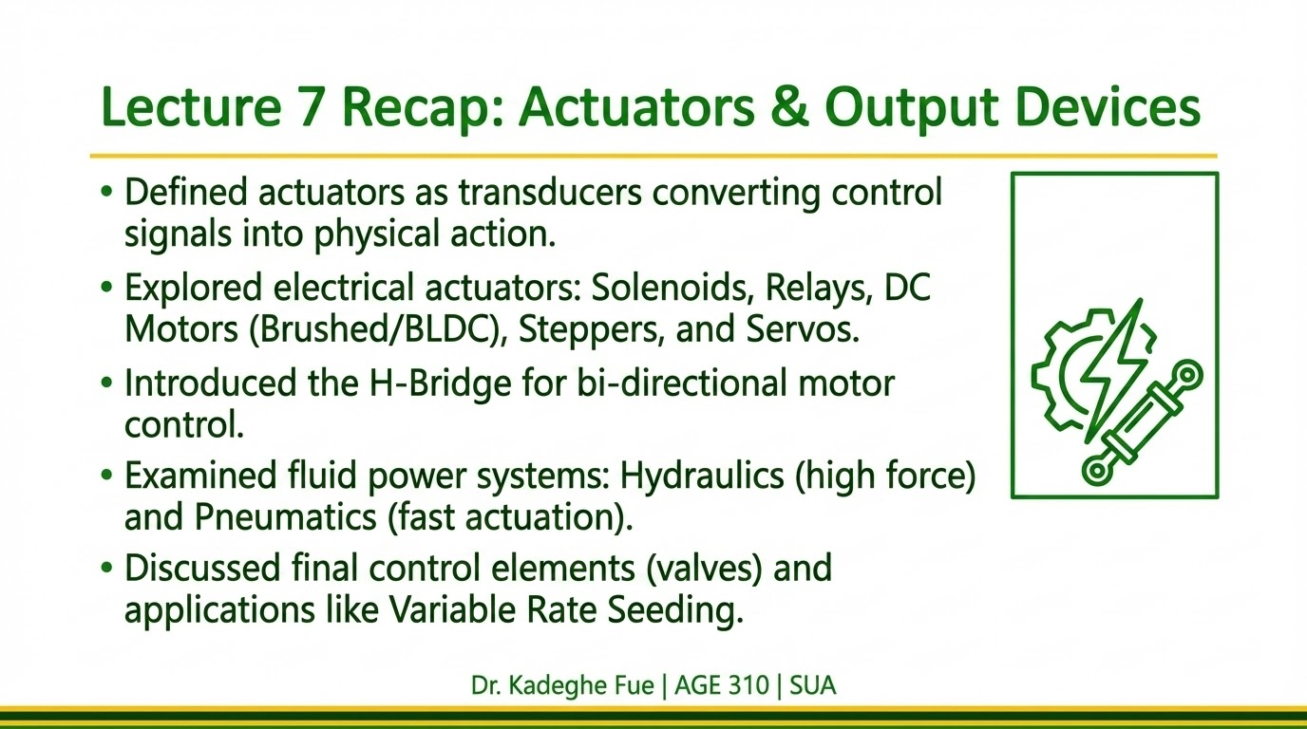

Slide 18

Questions?
End of Lecture 7
Assignment: Compare a Hydraulic Motor vs an Electric Motor for driving a fertilizer spinner. List pros/cons.
Dr. Kadeghe Fue | AGE 310 | SUA

